Slide 1
CS103 Introduction to Programming
Overview of C Programming Language

Slide 2
History of C
Originally developed in the 1970’s by Dennis Ritchie at AT&T Bell Laboratories.
  Outgrowth of two earlier languages BCPL and B.
Popularity became widespread by the mid 1980’s, with the availability of compilers for various platforms.
Standardization has been carried out to make the various C implementations compatible.
  American National Standards Institute (ANSI)
  GNU

Slide 3
Why C?
C is small (only 32 keywords).
C is common (lots of C code about).
C is stable (the language doesn’t change much).
C is quick running.
C is the basis for many other languages (Java, C++).
It may not feel like it but C is one of the easiest languages to learn.

Slide 4
Why C?
Programs written in C are efficient and fast.
There are only 32 keywords in ANSI C and its strength lies in its built in functions.
C is highly portable language.
C language is well suited for structured programming, thus requiring the user to think of a problem in terms of function modules or blocks.
Major parts of popular operating systems like Windows, UNIX, Linux is still written in C.

Slide 5
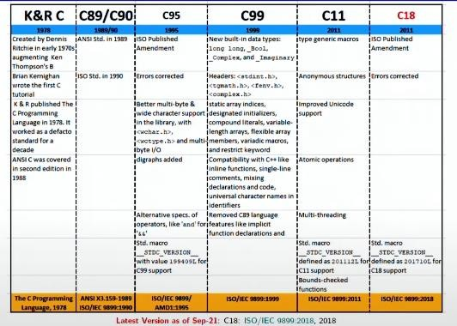
C Standards:

Slide 6
Some programmer jargon:
Some words that will be used a lot:
  Source code: The stuff you type into the computer. The program you are writing.
  Compile (build): Taking source code and making a program that the computer can
understand.
  Executable: The compiled program that the computer can run.
  Language: The core part of C central to writing C code.
  Library: Added functions for C programming which are bolted on to do certain tasks.
  Header file: Files ending in .h which are included at the start of source code.

Slide 7
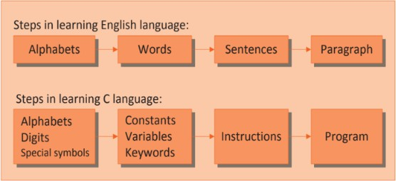
Getting Started with C

Slide 8
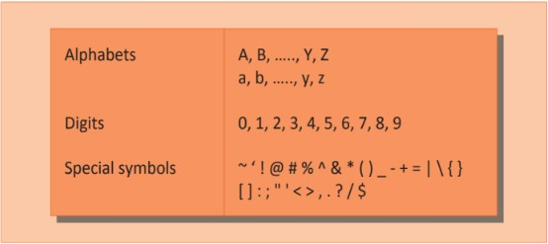
The C Character Set
The C language alphabet:
  Uppercase letters ‘A’ to ‘Z’
  Lowercase letters ‘a’ to ‘z’
  Digits ‘0’ to ‘9’
  Certain special characters:
! | # | % | ^ | & | * | ( | )
- | _ | + | = | ~ | [ | ] | \
| | ; | : | ‘ | “ | { | } | ,
. | < | > | / | ? | blank

Slide 9
Constants, Variables and Keywords :
The alphabets, numbers and special symbols when properly combined form constants, variables and keywords.
Define Constant and Variables.
In any program we typically do lots of calculations. The results of these calculations are stored in computers memory.
To make the retrieval and usage of these values easy these memory cells (also called memory locations) are given names.
Since the value stored in each location may change the names given to these locations are called variable names.

Slide 10
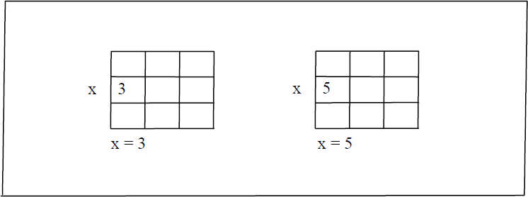
Constants, Variables and Keywords :
In Programming languages, constants are often called literals, whereas
variables are called Identifiers.
Since the location whose name is x can hold different values at different times x is known as a variable. As against this, 3 or 5 do not change, hence are known as constants.

Slide 11
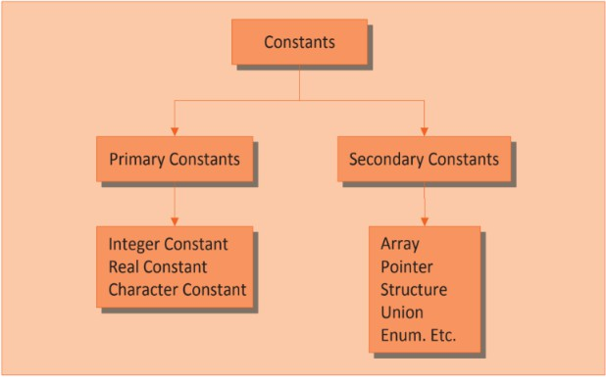
Types of C Constants:

Slide 12

Rules for Constructing Integer Constants:
An integer constant must have at least one digit.
It must not have a decimal point.
It can be either positive or negative.
If no sign precedes an integer constant it is assumed to be positive.
No commas or blanks are allowed within an integer constant.
The allowable range for integer constants is -2147483648 to
+2147483647.
Note: the range of an Integer constant depends upon the compiler.

Slide 13
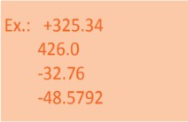
Rules for Constructing Real Constants:
Real constants are often called Floating Point constants. The real constants could be written in two forms—Fractional form and Exponential form.
A real constant must have at least one digit.
It must have a decimal point.
It could be either positive or negative.
Default sign is positive.
No commas or blanks are allowed within a real constant.

Slide 14
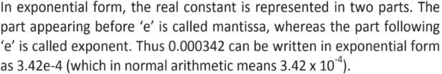
Rules for Constructing Real Constants:
The exponential form of representation of real constants is usually used if the value of the constant is either too small or too large.

Slide 15

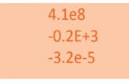
Rules for Constructing Real Constants:
Following rules must be observed while constructing real constants expressed in exponential form:
The mantissa part and the exponential part should be separated by a letter e or E.
The mantissa part may have a positive or negative sign.
Default sign of mantissa part is positive.
The exponent must have at least one digit, which must be a positive or negative integer. Default sign is positive.
Range of real constants expressed in exponential form is -3.4e38 to 3.4e38.

Slide 16
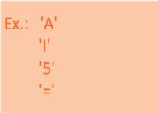
Rules for Constructing Character Constants:
A character constant is a single alphabet, a single digit or a single special symbol enclosed within single inverted commas.
The maximum length of a character constant can be 1 character.
C supports some backslash character constants that are used in output functions. For example, the symbol ‘\n’ stands for newline character.

Slide 17
String Constants
Sequence of characters enclosed in double quotes.
  The characters may be letters, numbers, special characters and blank spaces.
Examples:
“nice”, “Good Morning”, “3+6”, “3”, “C”
Differences from character constants:
  ‘C’ and “C” are not equivalent.
  ‘C’ has an equivalent integer value while “C” does not.

Slide 18
Types of C Variables:
Variable names are names given to locations in memory.
These locations can contain integer, real or character constants.
In any language, the types of variables that it can support depend on the types of constants that it can handle. This is because a particular type of variable can hold only the same type of constant.
For example, an integer variable can hold only an integer constant, a real variable can hold only a real constant and a character variable can hold only a character constant.

Slide 19

Rules for Constructing Variable Names:
A variable name is any combination of 1 to 31 alphabets, digits or underscores. Some compilers allow variable names whose length could be up to 247 characters. Still, it would be safer to stick to the rule of 31 characters. Do not create unnecessarily long variable names.
The first character in the variable name must be an alphabet or underscore.
No commas or blanks are allowed within a variable name.
No special symbol other than an underscore (as in gross_sal) can be used in a variable name.

Slide 20
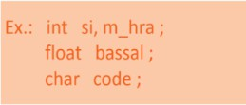
Rules for Constructing Variable Names:
It is a good practice to exploit this enormous choice in naming variables by using meaningful variable names.
For Example: if we want to calculate simple interest, it is always advisable to construct meaningful variable names like prin, roi, noy to represent Principle, Rate of interest and Number of years rather than using the variables a, b, c.
C compiler is able to distinguish between the variable names by making it compulsory for you to declare the type of any variable name that you wish to use in a program. This type declaration is done at the beginning of the program.

Slide 21
Valid and Invalid Identifiers:
Valid identifiers
X
abc
simple_interest a123
LIST
stud_name Empl_1 Empl_2
avg_empl_salary
Invalid identifiers
10abc my-name
“hello”
simple interest (area)
%rate

Slide 22
VARIABLES:ATTRIBUTES
All variables have three important attributes:
  A data type that is established when the variable is defined, e.g., integer, real, character. Once defined , the type of a C variable cannot be changed.
  A name of the variable.
  A value that can be changed by assigning a new value to the variable. The kind of values a variable can assume depends on its type. For example, an integer variable can only take integer values, e.g., 2, 100, –12.

Slide 23
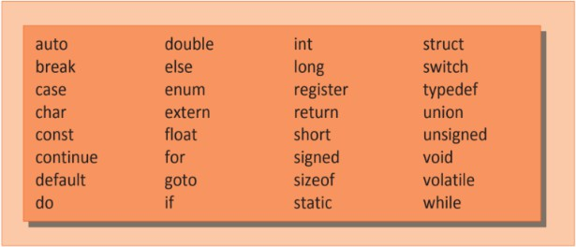
C Keywords:
Keywords are the words whose meaning has already been explained to the C compiler.
The keywords are also called ‘Reserved words’.

Slide 24
Keywords of C
Flow control – if, else, return, switch, case, default
Loops – for, do, while, break, continue
Common types – int, float, double, char, void
Structures – struct, typedef, union
Counting and sizing things – enum, sizeof
Rare but still useful types – extern, signed, unsigned, long, short, static, const
Evil keywords which we avoid – goto
Weird – auto, register, volatile

Slide 25
Developing Program in C
There are mainly three steps in developing a program in C
  Writing the C program.
  Compiling the program and
  Executing it.
To carry out these, some software components are required, namely an
operating system, a text editor, the c compiler, assembler, and linker.
The Editors which offers a complete environment for writing, developing, modifying, deploying, testing, and debugging the programs. Such software is referred to as Integrated Development Environment (IDE).

Slide 26
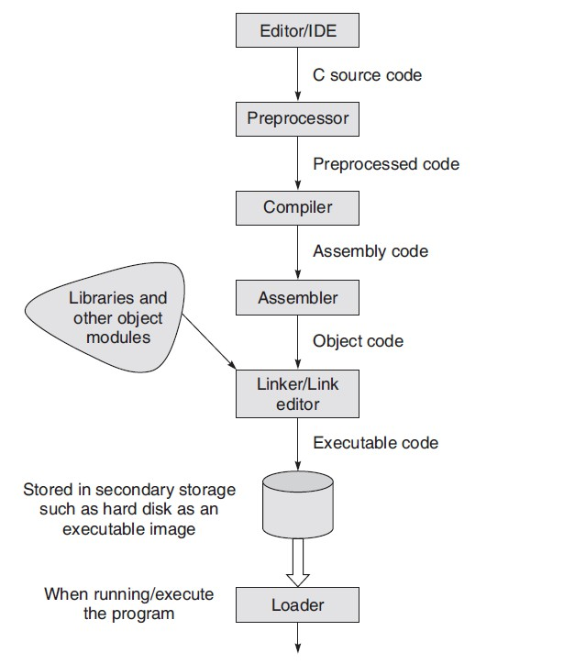
Dev C++ / vi editor
# define
Typical Steps for entering, compiling,
and executing C programs

Slide 27
Developing Program in C
The process of compiling and linking a program is often called building. The final linked file, which is in an executable object code format, is stored in another file on the system, ready to be run or executed. Under UNIX, this file is called a.out by default. Under Windows, the executable file usually has the same name as the source file, with the .c extension replaced by an exe extension.
Compile Error :
Linking Error :
Runtime Error:

Slide 28
The editor is also used to make subsequent changes to the program. To create or edit a file called ‘first.c’ using vi editor, the user has to enter vi first.c
To compile a C program in UNIX simply invoke the command CC. The command must be followed by the name of the C program that has to be compiled.
  cc first.c (in Unix)
  gcc first.c (in Linux) The GNU C compiler gcc is popular and available for many platforms.
It is more convenient to use –o and file name in the compilation as cc –o program first.c
To run the executable file, the command for both UNIX and LINUX operating system is ./a.out

Slide 29
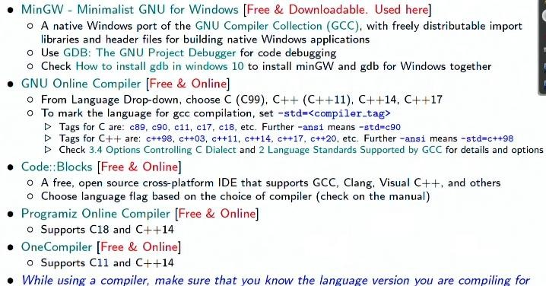
Tools:

Slide 30






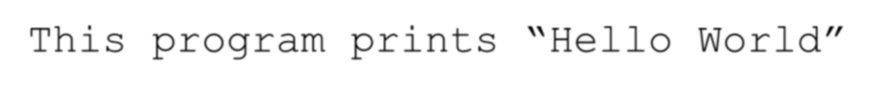












Our First C Program: Hello World
Preprocessor
#include <stdio.h>
Comments are good
/* This program prints “Hello World” */
main( ) means “start here”
main()
{
printf(“Hello World!\n”);
}
Library command
Brackets define code blocks

Slide 31
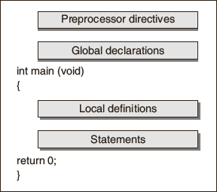
STRUCTURE : C PROGRAM

Slide 32
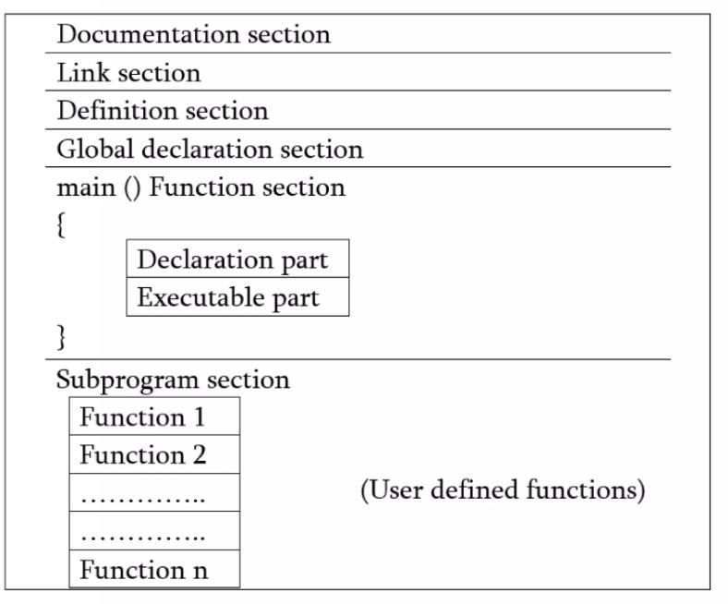
Basic Structure of C Programs:

Slide 33
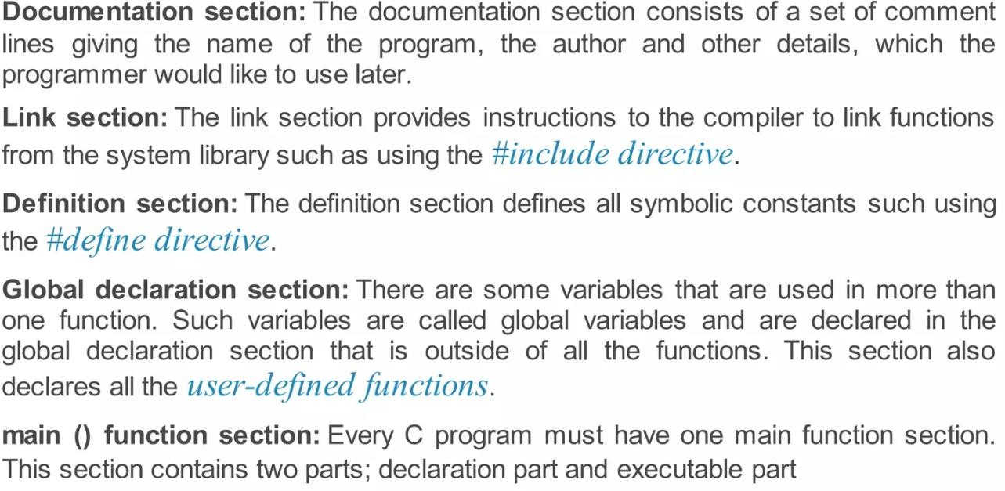
Basic Structure of C Programs:

Slide 34
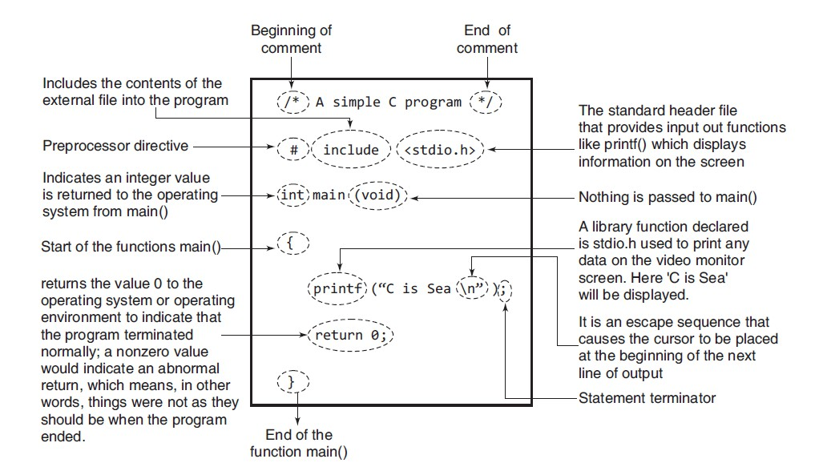

Slide 35
Form of a C Program:
Before we begin with our first C program do remember the following rules that are applicable to all C programs:
Each instruction in a C program is written as a separate statement.
The statements in a program must appear in the same order in which we wish them to be executed.
Blank spaces may be inserted between two words to improve the readability of the statement. However, no blank spaces are allowed within a variable, constant or keyword.
All statements are entered in small case letters.
C has no specific rules for the position at which a statement is to be written. That’s why it is often called a free-form language.
Every C statement must end with a ;. Thus ; acts as a statement terminator.

Slide 36
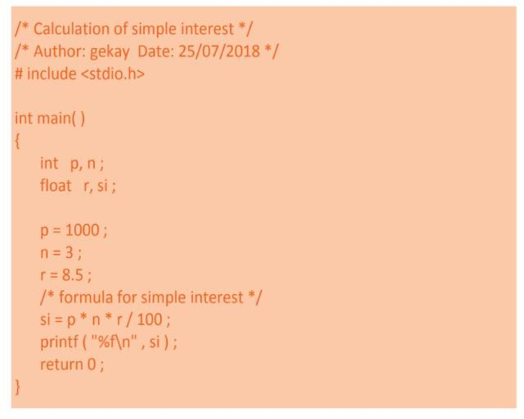
The First C Program:

Slide 37

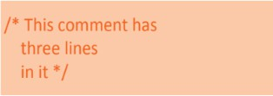
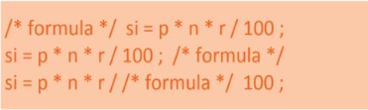
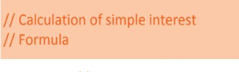

Comments in C Program:

Slide 38
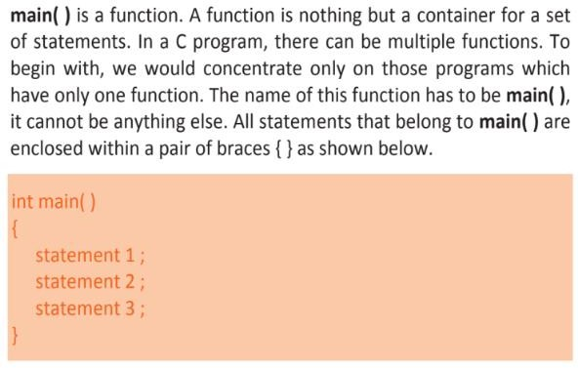
What is main()?

Slide 39
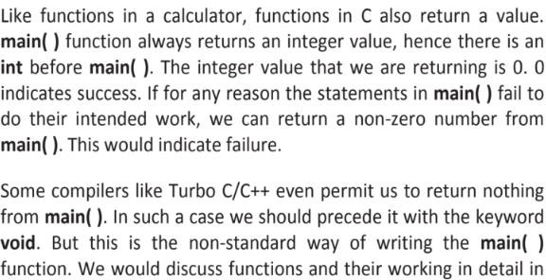
What is main()?

Slide 40
What is main()?
C permits different forms of main statement.
main()
int main()
void main()
main(void)
void main(void)
int main(void)

Slide 41
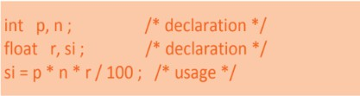
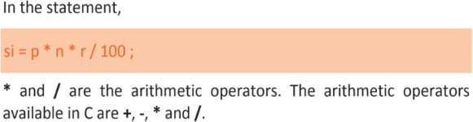
Variables and their Usage:

Slide 42
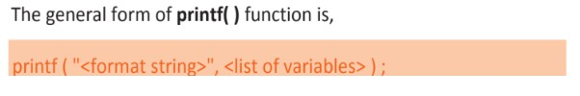
printf and its purpose:
C does not contain any keyword to display output on the screen.
All output to screen is achieved using readymade library functions like
printf().
Once the value of si is calculated it needs to be displayed on the screen. Unlike other languages, C does not contain any instruction to display output on the screen. All output to screen is achieved using readymade library functions. One such function is printf( ). We have used it to display on the screen the value contained in si.
⚫

Slide 43
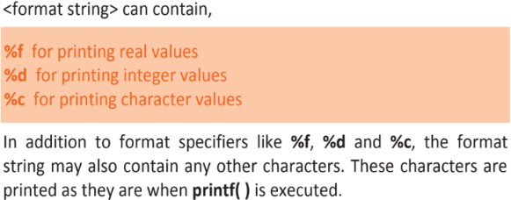
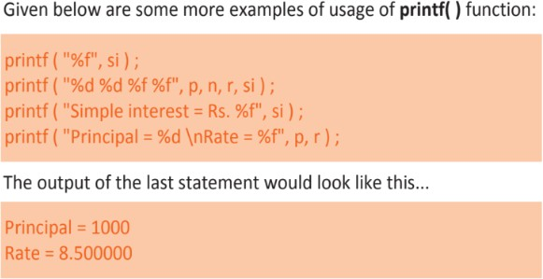
printf and its purpose:

Slide 44
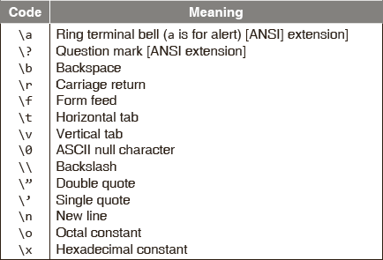
BACKSLASH CODE

Slide 45
Input and Output:
C Programming has been provided with some input instructions that are in fact a set of functions.
A function is a code segment that is complete in itself and does some particular task as and when it is called.
The scanf() function does not prompt for an input. It is a good programming practice to always use a printf() function before a scanf() function for users of the program to know what they should enter through the keyboard.
The input/output functions are of two kinds: nonformatted and
formatted functions.

Slide 46
Non-Formatted Input and Output:
Non-formatted input and output can be carried out by standard input- output library functions in C.
These can handle one character at a time. For the input functions it does not require <Enter> to be pressed after the entry of the character.
For output functions, it prints a single character on the console.

Slide 47
Single Character Input and Output:
A number of functions provide for character-oriented input and output. The declarations format of two of these are given as follows:
getchar(void);
//function for character input
putchar(int c);
//function of character output
getchar() is an input function that reads a single character from the standard input device, normally a keyboard.
putchar() is an output function that writes a single character on the standard output device, the display screen.

Slide 48
Single Character Input:
The getchar() input function reads an unsigned char from the input stream stdin.
The character, obtained from the input stream, is treated as an unsigned char and is converted to an int, which is the return value.
To read a single character from the keyboard, the general form of the statement used to call the getchar() function is given as follows:
char_variable = getchar();
where char_variable is the name of a variable of type char.

Slide 49
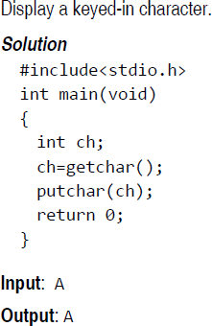
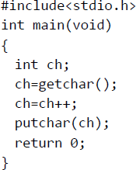
getchar(), the single character input function, reads a one byte character input from the keyboard.
putchar(), the single character output function, displays a one byte character on the monitor screen.

Slide 50
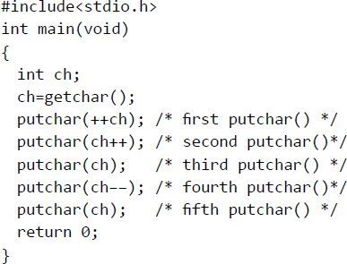
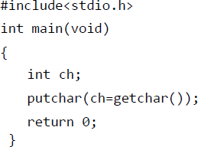

Slide 51


Formatted Input and Output:
#include <stdio.h>
int main()
{
char ch = 'A'; printf("%c\n", ch);
printf("%d\n", ch); return 0;
}
#include <stdio.h>
int main()
{
int x = 45, y = 90; printf("%d\n", x);
printf("%i\n", x); return 0;
}

Slide 52


Formatted Input and Output:
#include <stdio.h> int main()
{
float a = 12.67;
printf("%f\n", a);
printf("%e\n", a); return 0;
}
#include <stdio.h> int main()
{
int a = 67; printf("%o\n", a); return 0;
}

Slide 53


Formatted Input and Output:
#include <stdio.h>
#include <stdio.h> int main()
{
int a = 15; printf("%x\n", a); return 0;
}
int main()
{
double a = 0.0; scanf("%lf", &a);
printf("%lf\n", a);
return 0;
}

Slide 54


Formatted Input and Output:
#include <stdio.h>
int main()
{
char ch;
printf(“Enter character \n”);
scanf("%c", &ch);
printf("%c\n", ch); return 0;
}
#include <stdio.h>
int main()
{
char str[20];
print f(“Enter String \n”)
scanf("%s", str);
printf("%s\n", str); return 0;
}

Slide 55
Thank You..!!

